Slide 1
Relationship Between Google Reviews And Doordash Reviews
Name:
Instructor:
Date:

Slide 2
Introduction
This study will examine whether there is a relationship between the overall google reviews for the restaurants and reviews from Doordash.
Testing hypotheses will be vital in determining whether google reviewers had same opinion with Doordash reviewers.

Slide 3
Research Question and Hypotheses
Research question:
Is there statistical significant relationship between google reviews and Doordash reviews?
Hypotheses:
H₀: There is no statistical significant relationship between google reviews and Doordash reviews.
H_{a}: There is a statistical significant relationship between google reviews and Doordash reviews.

Slide 4
Variables
Two continuous variables were used in this study.
The google reviews and the Doordash reviews were examined to understand the relationship between them.

Slide 5
Statistical Test Used
Correlation analysis was the most appropriate test statistics in this study.
The test was suitable since we have two variables that are quantitative and the research aims at examining the relationship between them (Makowski et al., 2020).

Slide 6
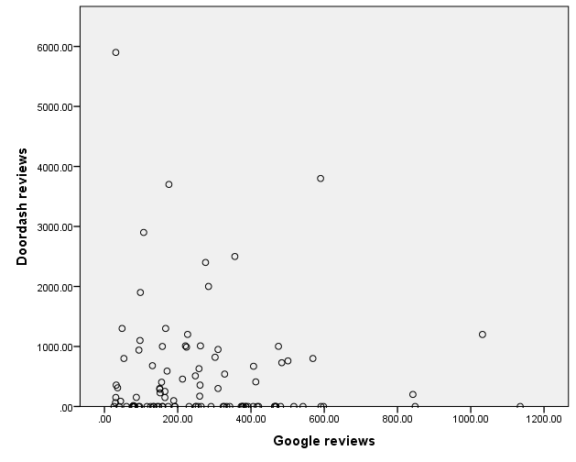
Results
Figure shows a scatterplot to visually represent the relationship of the two variables which indicated a rather weak insignificant relationship between the variables.
Figure 1

Slide 7
Results Continued …
Table 1 shows the results of the correlation analysis.
The results showed that there was a very weak negative relationship between google reviews and Doordash reviews since r = -0.06, p = 0.58 (Warner, 2020).
Correlations
 |  | Google reviews | Doordash reviews
Google reviews | Pearson Correlation | 1 | -.055
 | Sig. (2-tailed) |  | .579
 | N | 103 | 103
Doordash reviews | Pearson Correlation | -.055 | 1
 | Sig. (2-tailed) | .579
 | N | 103 | 103

Slide 8
Conclusion
Since the p-value was greater than the significant level of 0.05, we fail to reject the null hypothesis and conclude that there is no statistical significant relationship between google reviews and Doordash reviews.

Slide 9
Reference
Makowski, D., Ben-Shachar, M. S., Patil, I., & Lüdecke, D. (2020). Methods and algorithms for correlation analysis in R. Journal of Open Source Software, 5(51), 2306.
Warner, R. M. (2020). Applied Statistics I: Basic Bivariate Techniques. SAGE Publications.

